Slide 1

Electric Blocks
Snapshot #1

Slide 2
Project Definition
Enable the creation and use of realistic and accurate virtual reality models of electric power transmission, distribution, control, and usage scenarios for research and instruction.
Our client is looking for a way to make modeling power grids far easier than any of the current solutions.
Client suggested developing a Minecraft or Minetest mod for this purpose.

Slide 3
Project Background
Currently, anyone who wants to create power flow models faces many challenges. Industry standard power flow modeling software:
Is very expensive
Is hard to use
Is difficult to visualize
Requires the user to have a strong background in electrical engineering
Requires application specific knowledge to use properly (such as a custom scripting language or file format)
Feels disconnected from real world applications.

Slide 4
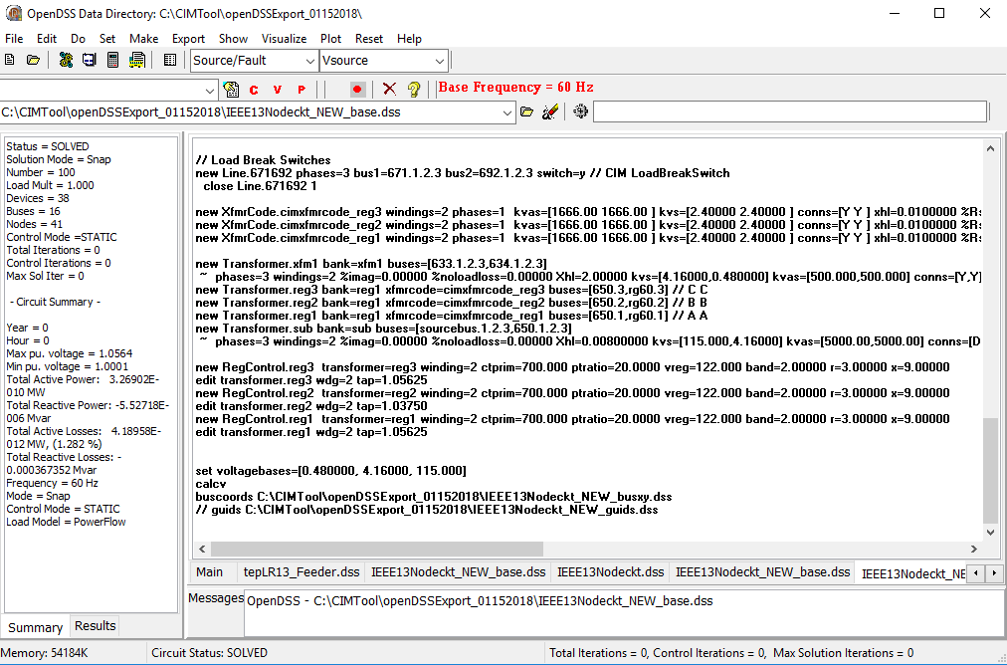

Slide 5
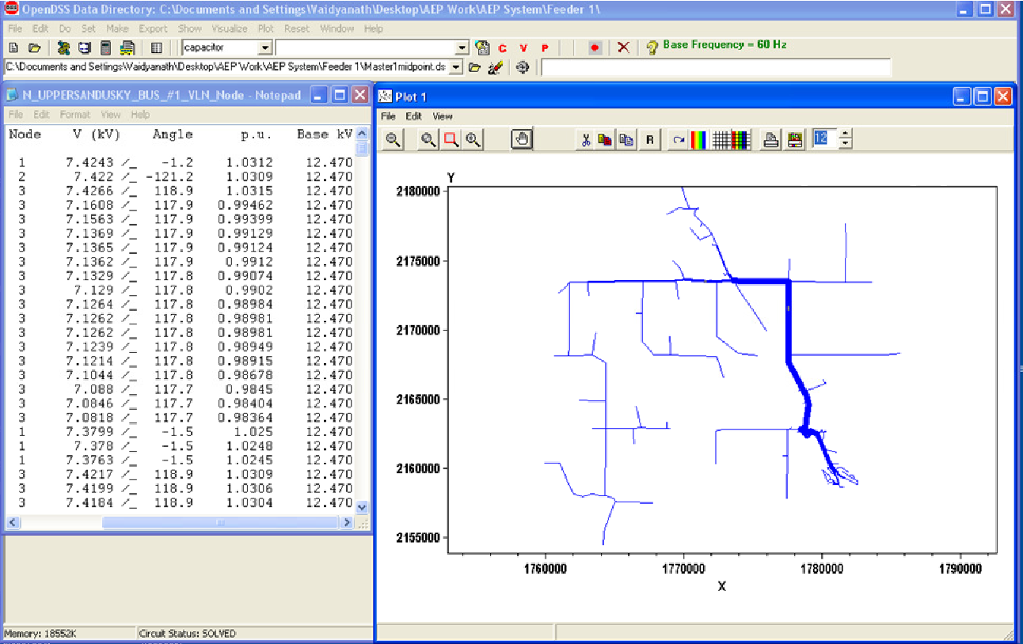

Slide 6
Project Background (cont.)
Our client wanted for us to develop software that addressed all of these issues. Once we are done, we will have a system for modeling power flow that:
Is cheap to use
Is easy to use
Is easy to visualize
Doesn’t require any electrical/power engineering background
Requires little to no application specific knowledge to use
Feels directly connected to real world applications

Slide 7
Other Projects
While there are several mods for energy and power flow in Minecraft already, these do not model electrical systems and their operations and control in a way that is realistic enough to enable quality research and education in power systems.
This meant it was vital for us to utilize rigorously engineered and validated software that would provide realistic results.
Our main criteria for selecting this software was ease of use, support for asymmetric three phase power, and cross-platform compatibility. We ended up settling on PandaPower.

Slide 8

Initial Research
To meet our project goals we decided to create two separate software packages:
Minecraft: Java Edition mod as our target/user platform with MC Forge as our modding platform
HTTP REST Web Server w/ JSON for interfacing with power flow simulator
Both packages are released to the public for free and feature an open source strong copyleft license.

Slide 9



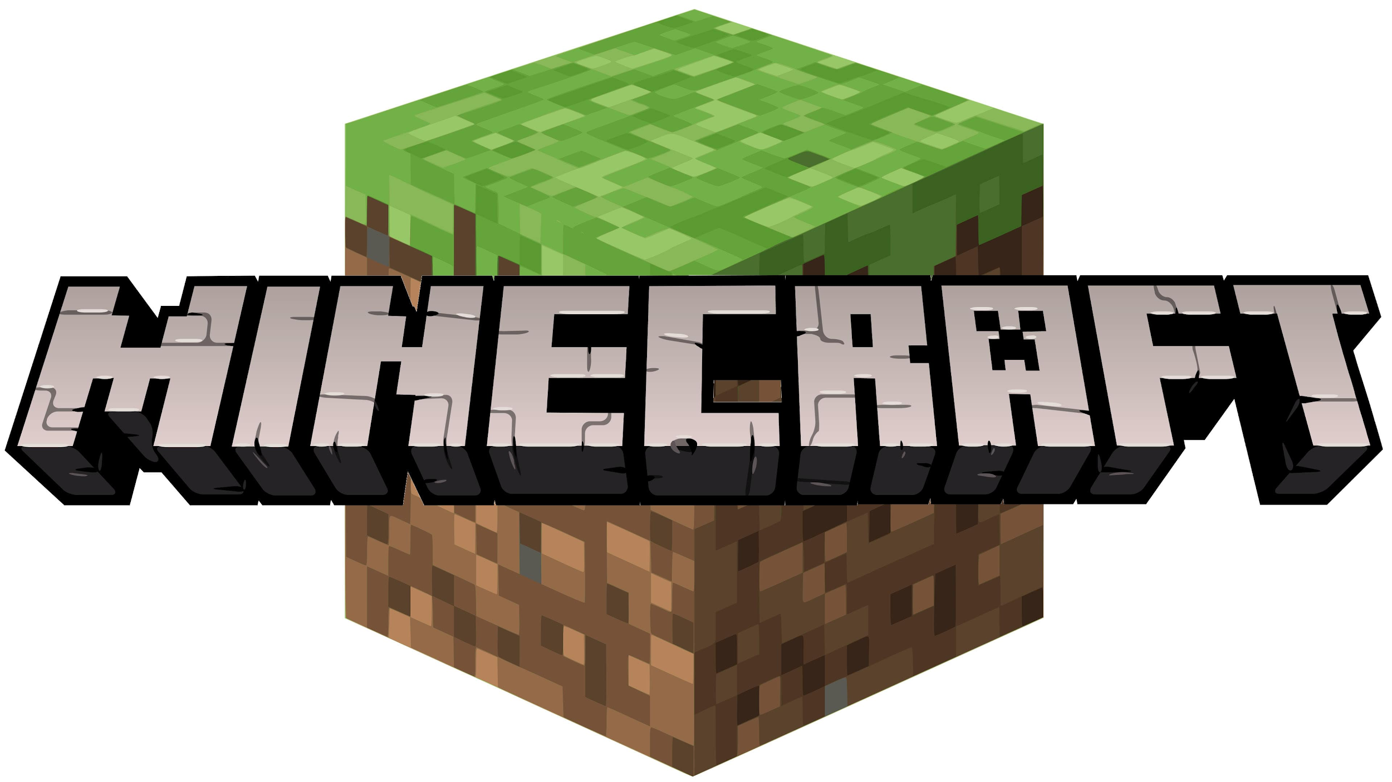


Tech Stacks
EBPP

Slide 10
Electric Blocks Mod
We settled on creating a Minecraft mod as the game is relatively cheap and one of the most popular games in the world. This makes installing and using the mod a familiar process for many.
MC Forge has long been the standard for creating mods in Minecraft.

Slide 11
Electric Blocks Mod Challenges
Create blocks representing electric grid components such as buses, lines, transformers, loads, switches, storage, external grids, generators, etc.
Allow these blocks to be connected into a network and then simulated using PandaPower.
Allow the player to view the results of network simulations using chat and eventually tools like multimeters.
Give these blocks somewhat realistic in-game functionality such as turning on lights or furnaces.

Slide 12
Electric Blocks Panda Power (EBPP)
An HTTP Rest Server works on nearly any platform (Windows, Mac, Linux, etc)
Built on Flask API for quick and minimal design.
Native support for concurrent access/operations.
EBPP uses network sockets for communication so it doesn’t need to run on the same computer as the mod.
Can be run in a container.
Can be accessed by a multiplayer server or many multiplayer servers.

Slide 13
EBPP Challenges
Correctly receive and interpret requests for power flow simulations by the Electric Blocks Mod
Run the PandaPower simulation and send the results back to the Electric Blocks mod.

Slide 14
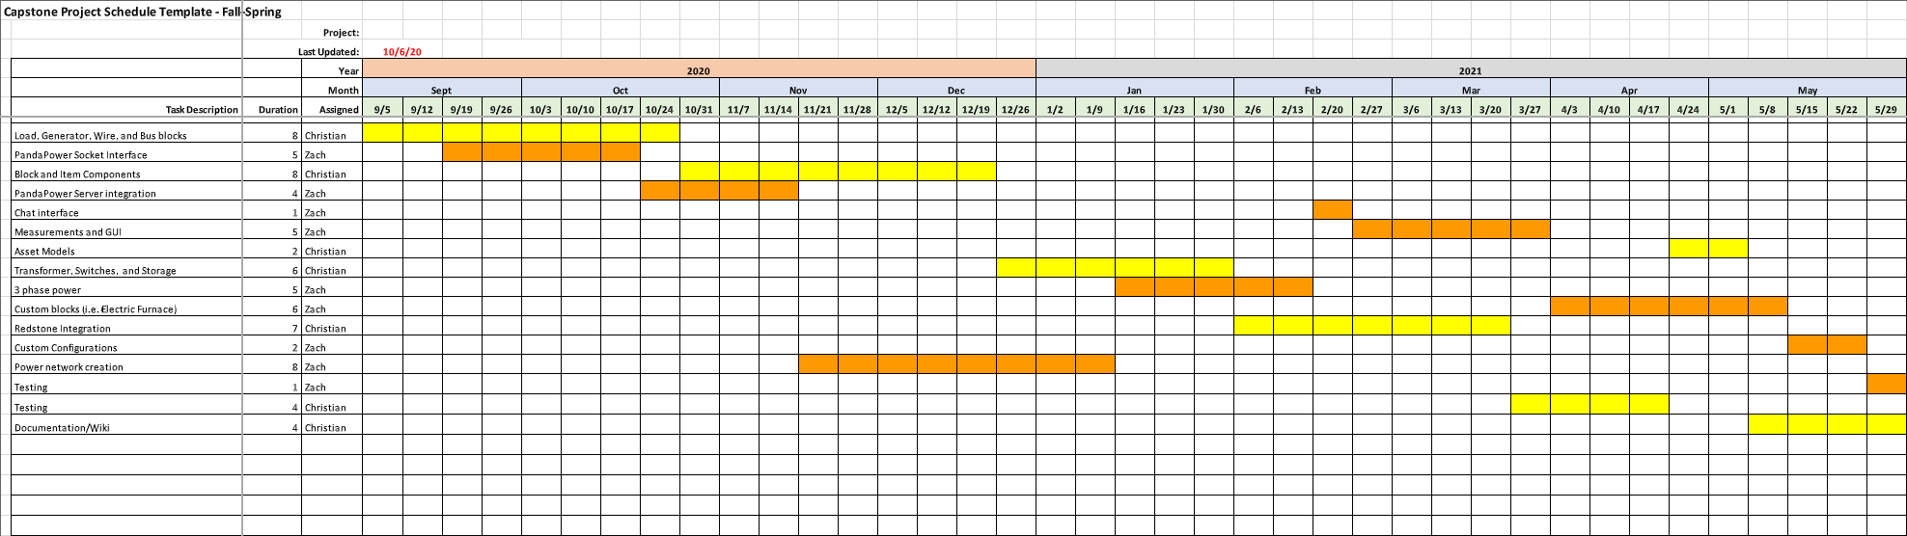
Schedule

Slide 15
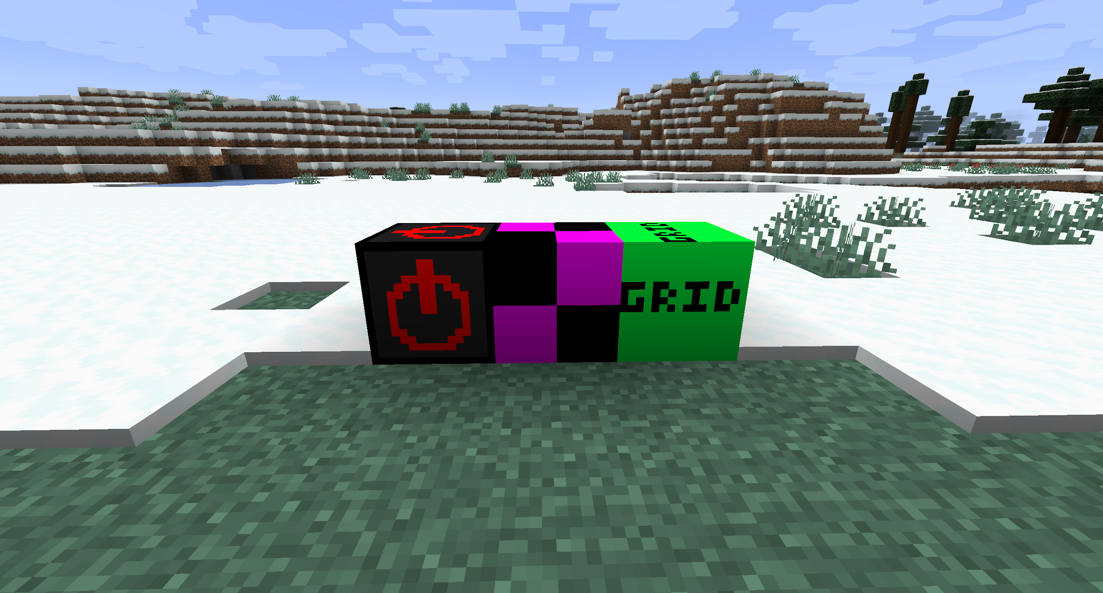
Current Progress
Several blocks have been added such as the external grid, portable generator, and lamp blocks.
Electric Blocks mod can detect when an electric block is placed or modified and send a simulation request to EBPP.
EBPP is capable of receiving those requests, running a simulation, and returning results for a subset of elements.

Slide 16
Roadmap
We still have not created a way to connect electrical grid elements and detect those connections to build complex networks. We are working on developing a model for this.
We have many more blocks to add into the game representing other electrical components.
EBPP does not support all electrical grid element types yet, but the framework is setup to make adding them simple.
We still need to create an easy way for users to view results of power flow. We have plans to start with a chat system and then move to a GUI.

